Slide 1
Duct Performance Analysis using Python
By plotting and fitting a graph between pressure and flow rate(velocity).
Submitted By:
Nitin Sethi

Slide 2
Contents:
Introduction
Problem Statement
Duct Design
Input Parameters
Losses in Duct
Curve Fitting
The Output
Results
References

Slide 3
Introduction- Working of a duct
Ducts are conduits or passages used in heating, ventilation, and air conditioning (HVAC) to deliver and remove air. The needed airflows include, for example, supply air, return air, and exhaust air. Ducts commonly also deliver ventilation air as part of the supply air. As such, air ducts are one method of ensuring acceptable indoor air quality as well as thermal comfort.[1]
Assumption:- The conveying fluid that flows through the duct system is air. Air transports materials from the hood to a destination. It is also instrumental in capturing the material into the flow system. Air is a compressible fluid, but for engineering calculations, air is considered as incompressible as a simplification, without any significant errors.[2]

Slide 4
Problem Statement
In this program, the intention is to analyze the duct system designing by creating a program in python, which after inputting of all the necessary factors and calculate the total flow rate and pressure drop and then plot the graph between them showing the relationship.
Also, perform the curve-fitting on the graph and calculate the mathematical relationship between them so the for any value of flow rate rate pressure drop can be predicted.

Slide 5
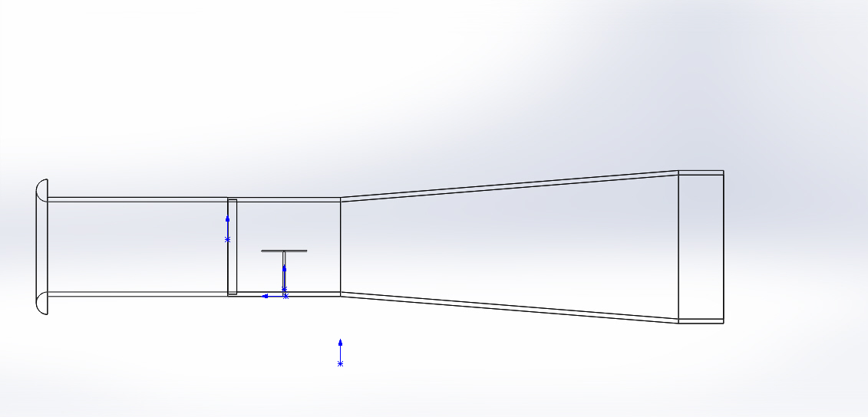
Duct Design

Slide 6
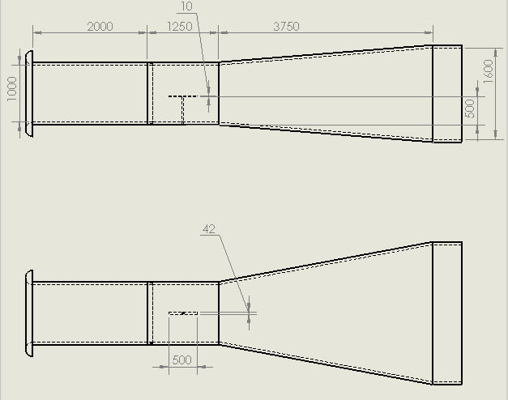
Duct Design and Dimension
The design is self created on solidworks but the idea has been taken from the research paper.
Link:[3] http://www.casde.iitb.ac.in/store/training/2003/kailash-wt-perf-analysis.pdf

Slide 7
Input Parameters[3]
Curved Radius at inlet= 0.125m
Length at inlet= 1m
Breadth at inlet= 1m
Length at outlet= 1.6m
Breadth at outlet= 2.4m
Obstruction dimension= 0.5*0.01

Slide 8
Losses in Duct
Minor Losses
Loss at inlet
Loss at obstructions
Loss at outlet
Loss at Duct Diffuser
Major Losses
1. Losses due to duct friction

Slide 9
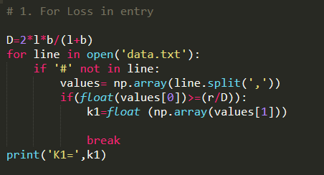
Loss at inlet
Equivalent Diameter = 2lb/(l+b)
Check r/D value against the profile
With python and input it.
#Losses at inlet[3]
#r/d , K1
0.03 , 0.3
0.05 , 0.2
0.10 , 0.06
0.15 , 0.06

Slide 10
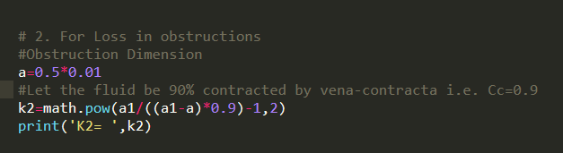
Loss at obstructions
As the liquid flows and passes through obstruction, a vena-contracta is formed beyond it, after which the stream of liquid widens again.[4]
K2= (a1/((a1-a)*0.9)-1)^2[4]
Here, 0.9 is an assumption that coefficient of contraction is 0.9.

Slide 11
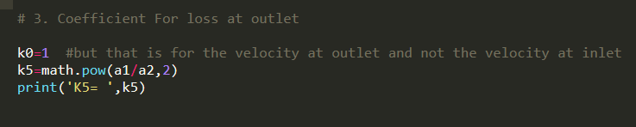
Loss at Outlet
But at outlet, velocity is different from that of the test section. For incompressible flow continuity eqn is given as
A1.V1 = A2.V2
V2 = (A1/A2).V1 = 0.2604.V1
Pressure lose at outlet
= ½.K3. ρ.(V2)^2
= ½. (0.0678).ρ. (V1)^2
Resultant K for losses at outlet = K3 = 0.0678

Slide 12
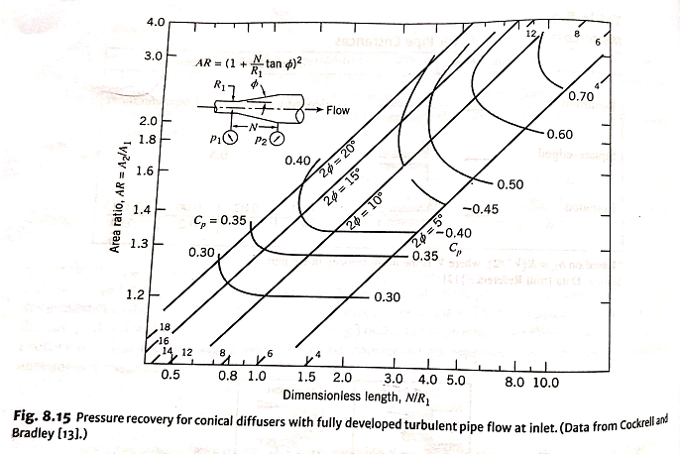
Loss at Duct Diffuser
Equivalent Diameter is given by
De= 1.265
Dimension Length is calculated as N/R1 as given in Figure.
From these, Cp is value is inputted and hence coefficient of loss is calculated as;
K4= 1--Cp

Slide 13
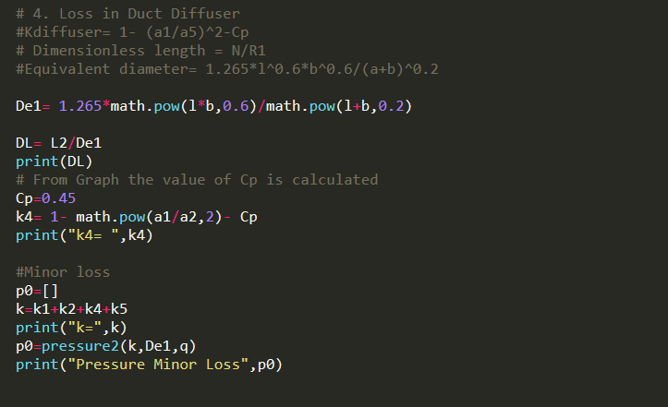
Total Minor Pressure Loss
The value of resultant K is obtained by summing all values of K’s.
K=K1+K2+K3+K4
Then, P0
= pressure drop minor loss
= K * 0.5 *ρ *
Where, ρ = 1.225 kg/m3.
In the end, the pressure loss is calculated using functions defined above.

Slide 14
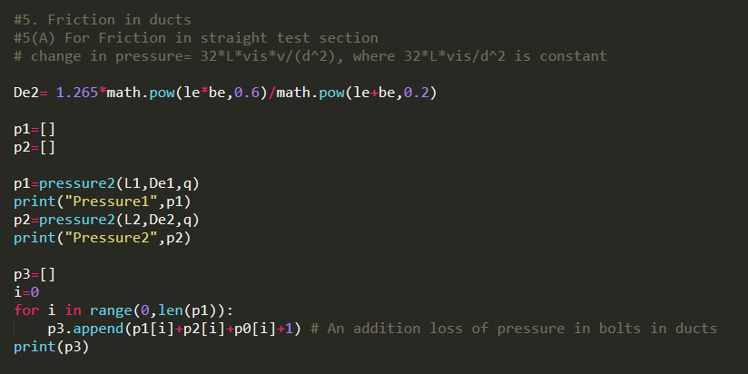
Duct Friction Loss
The basic thing to do is first calculate the avg, length and breadth of the duct diffuser and then the Equivalent diameter for the same. Then, the pressure is calculated for the uniform duct and duct diffuser using pressure2 function (explained later).
In the end all three pressures are added and the you have the final pressure list.
Therefore, pressure has been calculated. Now, the functions used for this calculation is :
friction_factor()+fun()+df()
pressure2()

Slide 15
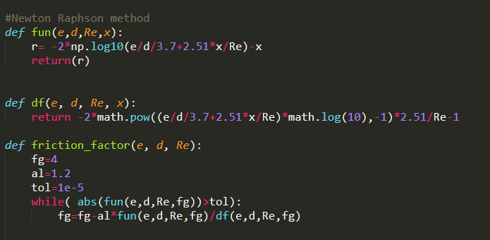
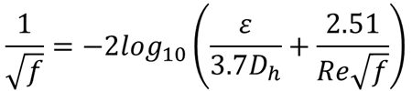
1. friction_factor()
Friction is calculated by solving a complex equation called Colebrook Equation, i.e.
Which is to be solved by using Newton-Raphson method
, is considered as x.
Therefore,
F= *x)-x
And
=-2*(**-1)

Slide 16
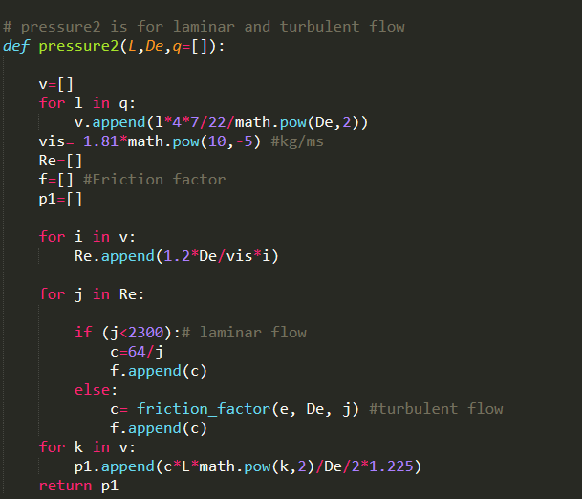
2. pressure2()
This function basically takes values of length, Equivalent diameter and flow rate as input and then ;
Calculates the velocity using
2. Calculating Reynold’s number
Re= where is Dynamic viscosity
3.Calculating Friction Factor , i.e.,
a) f=for Laminar flow
for turbulent
flow
c) Calculate pressure by Darcy Weisbach Equation:
p=

Slide 17
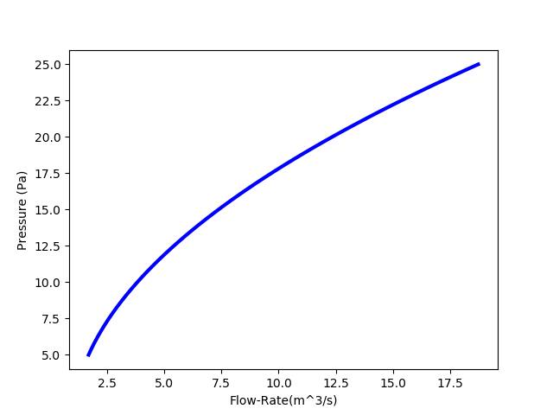
Curve Fitting
Curve Fitting is done in this program for two main reasons, namely:
To show the relation relationship between pressure and flow-rate.
To find how pressure is mathematically dependent on flow-rate and how this function can be used for other values of pressure at various flow-rates.
1.) Graph Obtained:

Slide 18
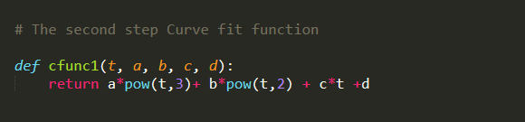
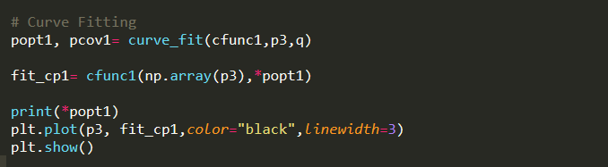
3) The graph shows the curve is showing characteristics of cubic. Therefore, it is assumed that it follows cubic equation and a function is this defined following the equation.
4) 1.) Popt: Popt gives the optimal values of the parameters. For ex: if the equation is ax+b, the curve_fit will return the optimal values of a & b in popt.
2.) Pcov: Pcov gives the estimated covariance of popt. It is used to calculate the standard deviation errors on the parameters using np.sqrt(np.diag(pcov)).

Slide 19
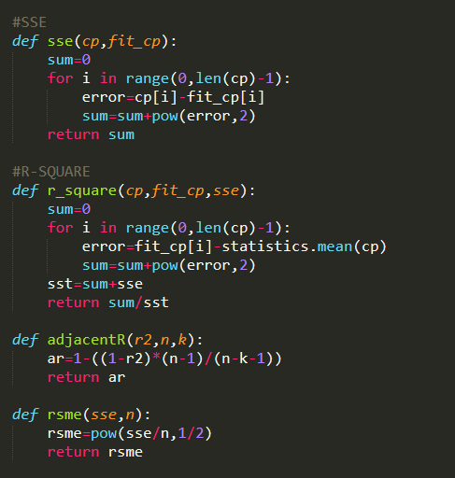
5.) Last step would be to Evaluate the ‘Goodness of Fit’, which can be calculated by :
SSE- Sum of Squares Due to Error
R-Square
AR- Adjusted R-Square
RMSE- Root Mean Square Error

Slide 20
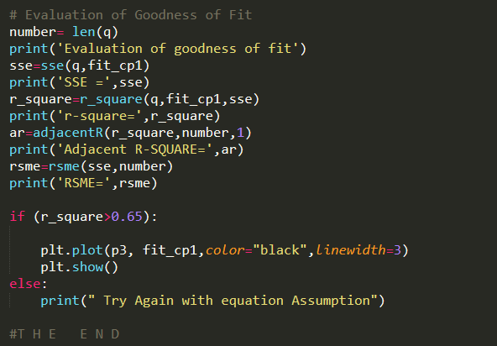
6.) In the end, we check the goodness of fit by checking whether R-Square is greater that 0.7.

Slide 21
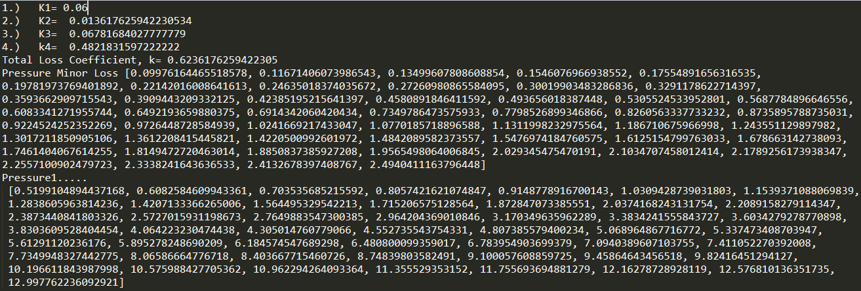
The Output

Slide 22
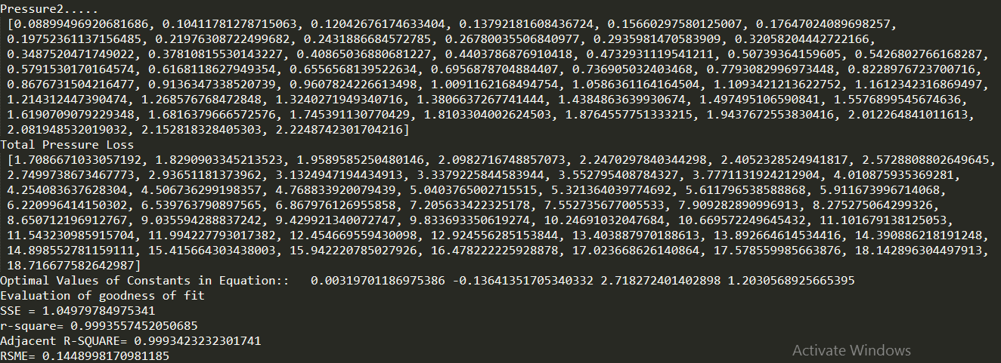

Slide 23
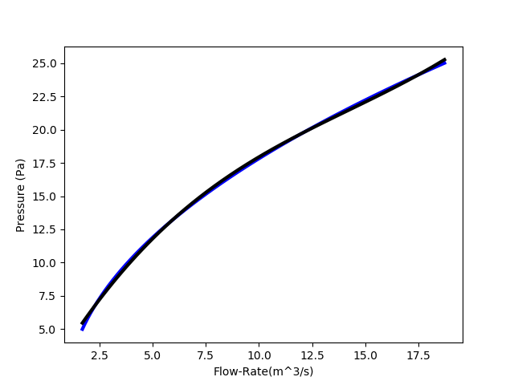
Curve Fitting

Slide 24
Results
This graph as well as mathematical function can now be used to select the optimum Flow-rate for a given pressure.
It can also be used to choose optimum flow-rate according to power of fan/ blower required as:
Preq = p*Q
3. This can be used in all ventilation systems.

Slide 25
References
[1] https://en.wikipedia.org/wiki/Duct_(flow)#Air_terminals
[2] https://en.wikipedia.org/wiki/Duct_(industrial_exhaust)
[3] http://www.casde.iitb.ac.in/store/training/2003/kailash-wt-perf-analysis.pdf
[4] http://www.iith.ac.in/~ksahu/class13_FM.pdf

Slide 26
Thank you for your time

